Slide 1
Language Detector
Team Members:
Jungmyun Kim
Chinchu John

Slide 2
Out lines
Picked 3 languages that uses Roman alphabet for its writing system.
Methodology
Train Data
SVC Algorithm
Result

Slide 3
Train Data
Source of Train Data:
Google News
Wikipedia
15 Set of train.txt data collected for each languages
Average 10 Kb size per each txt file.

Slide 4
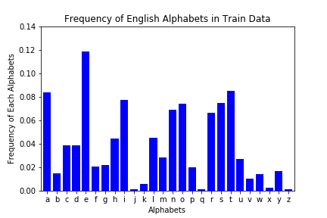
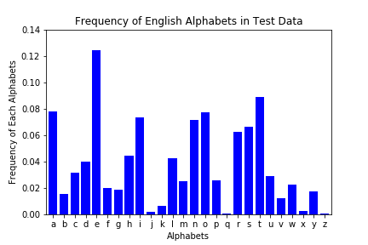
English

Slide 5
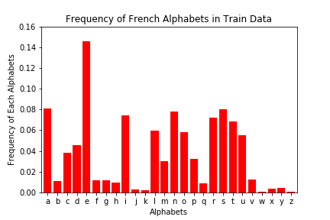
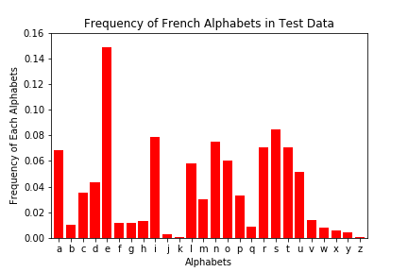
French

Slide 6
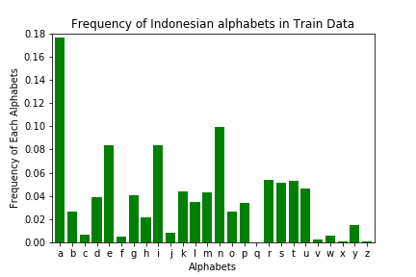
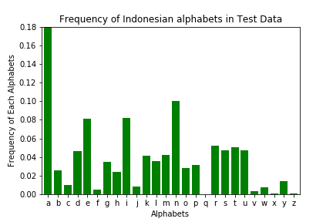
Indonesian

Slide 8
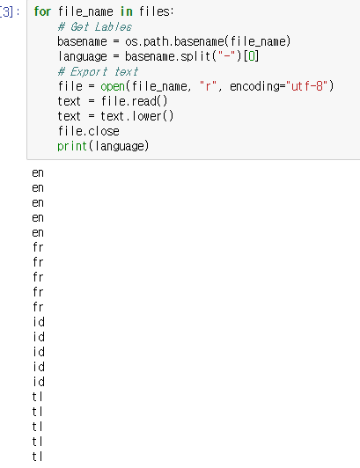
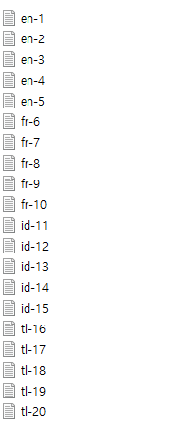

Slide 9
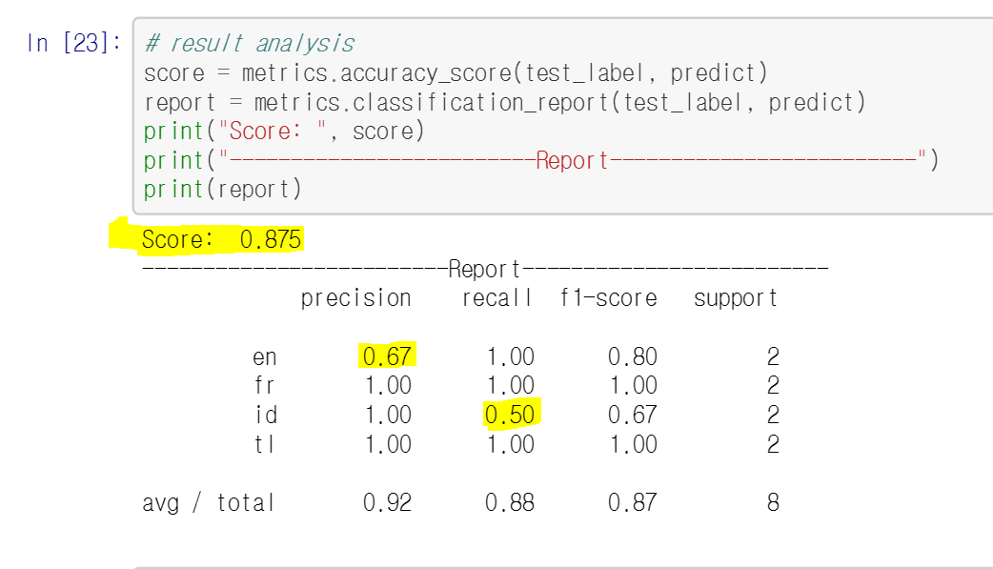
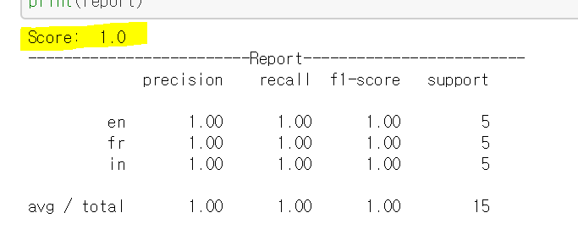
SVC Algorithm
As we add more train data the precision score increased from 87.5% to 100%

Slide 10
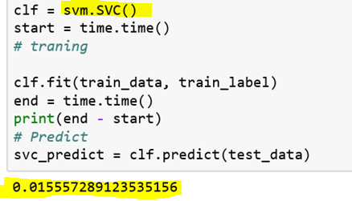
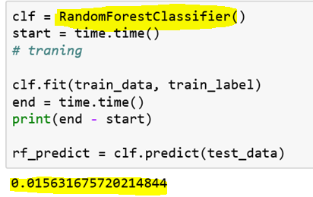
Random Forest Classifier
SVC algorithm and Random Forest both got precision score of 1.0
SVC algorithm performed slightly faster than Random Forest
>

Slide 11


Thank you!

